Slide 1
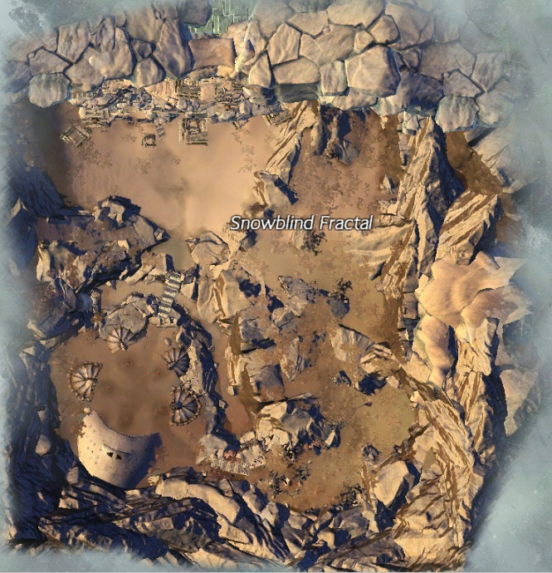
Snowblind Fractal
Scales:
3, 27, 51, 68, 86, 93
Step by Step Guide on What to Expect
By: Michie.4352

Slide 2
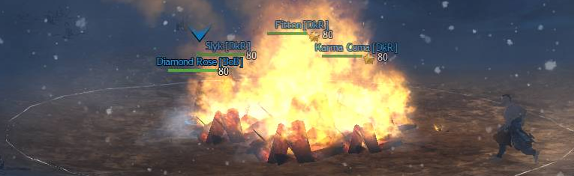
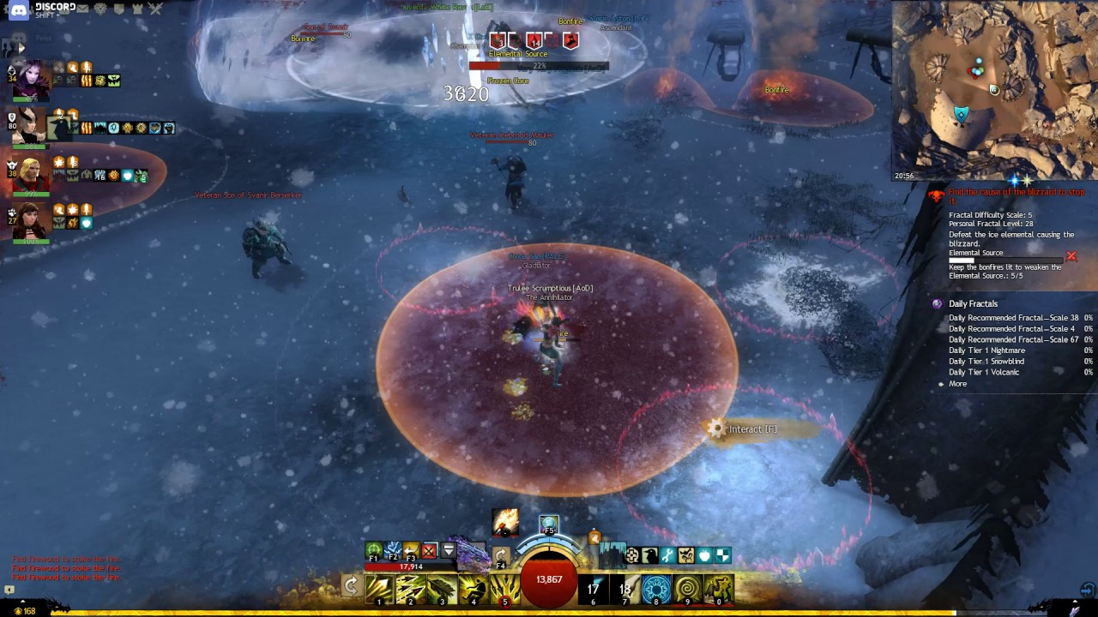
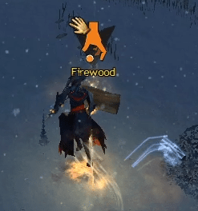
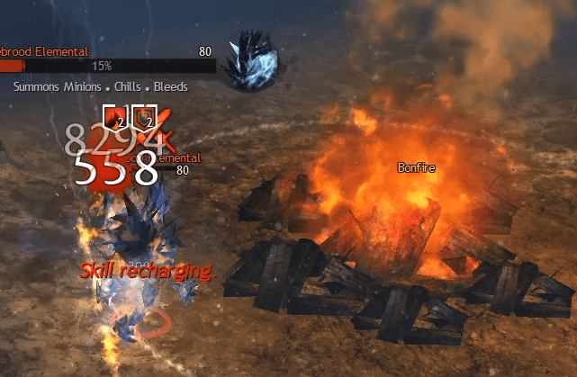
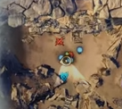
1. Mini Game – Bonfire Pt. 1
You’ll start inside of an Ice Cave, inside a bonfire. To start the mini game, you’ll have to run to the other bonfire outside of the cave and light it up using your special action key that pops up when you get close to the Bonfire
When you light up the bonfire, that’s when adds and Firewood will pop up everywhere
  Kill the Adds that pops up, Especially the Ice Elementals – Do not let it touch the Bonfire! Otherwise, the Elementals will melt and blow out the fire.
  Collect Firewood and throw them into the Bonfire to keep it lit up!
    You can check on your mini map where the Ice Elementals will spawn. It will have two swords making an X slowly moving towards the Bonfire!

Slide 3


2. Mini Game – Bonfire Pt. 2
You can look at the top right corner of your screen to know how many more Ice Elementals you need to kill and if the Bonfire need more firewood.
Once you are out of the Bonfire’s AOE, you will gain a Hypothermia debuff
  If it continues to stack (1 stack every 5 seconds), you will start walking super slow.
Best Strat: Grab a firewood, run back into the bonfire’s AOE and interact to drop the firewood. When you see the Ice Elemental, you will focus on killing it as fast as possible
Note: As you go higher in Tier, the Faster the Elementals come out and the faster it runs towards the Bonfire! Use knockbacks, stuns, any CC you have to slow it down!

Slide 4
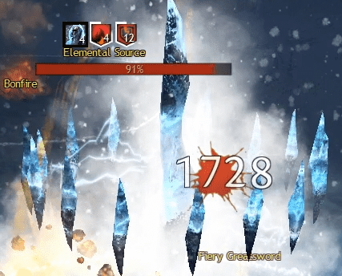
3. Mini Game/Boss: Elemental Source
Main Goal: Destroy the Elemental Core in the middle of the Village while keeping the 5 bonfires around the Core lit up as long as possible
  How?
    Keep 1-2 Bonfires lit up with Firewood at all times – You will need 1-2 players (Ranged Classes) to focus on keeping the bonfire up while the rest of the party destroys that Source
    Revenant with Bubble in Centaur Stance – A little Cheat ☺ Place the Bubble on top of the source so the ice projectiles that comes out of the Source won’t hit the bonfires! Those projectiles come out every 25%
Note: If you have all of the Bonfires blown out, you will get randomly teleported to a corner of the village with the debuff in effect.

Slide 5
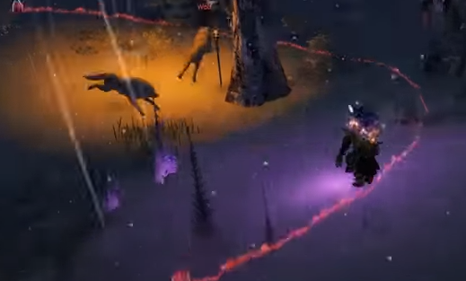

4. Mini-Game: Forest Run through
FOLLOW THE LIGHT!
Main Goal: Avoid all of the Adds trying to kill you and run as fast as possible to the end of the forest
  How? - There are Fire sticks on the ground that are lit up. Follow the fire to the end! Once one player gets to the end, you will see “Kill the Son of Svanir Shaman” pop up on the middle of your screen. That means you can type “/gg” to teleport to the end!

Slide 6
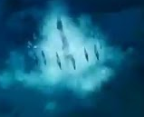
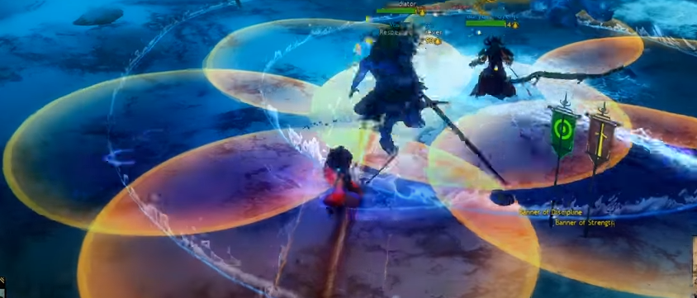
5. Final Boss: Legendary Shaman Lornarr Dragonseeker Pt. 1
Many Mechanics to look out for:
  Three Corrupted Ice Crystals at the Corners – These crystals shoot out ice projectiles just like the Elemental Source. Destroy those Crystals! It will take the shield buff off the Boss that reduces incoming damage.
  Multiple Red AOE’s that Causes Chilled – Avoid getting hit otherwise you will have a debuff stack. If you get up to 10 Stacks, you will be Frozen in place and become vulnerable to any of the Boss’s Attacks

Slide 7
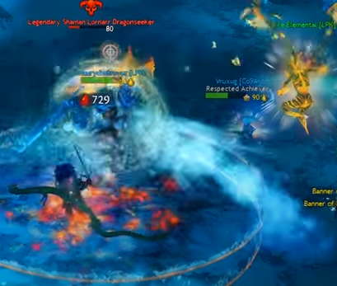
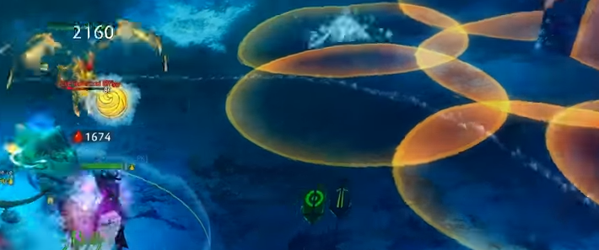
6. Final Boss: Shaman Lornarr DragonSeeker Pt. 2
  Icy Breath – The Boss won’t be able to move during this attack but you do want to stay out of it! Dodge at the last second if you want to greed DPS
Three Phases: 75%, 50% and 25%
  At these phases, the boss disappears, and an Icebrood Effigy comes out.
  Watch out for it’s multi-aoes that pops out! Ice shards will come down just like one of the bosses mechanic
Best Strat: Focus on killing the Effigy while avoiding ice falling AOE’s to get the boss to come back out again.

Slide 8
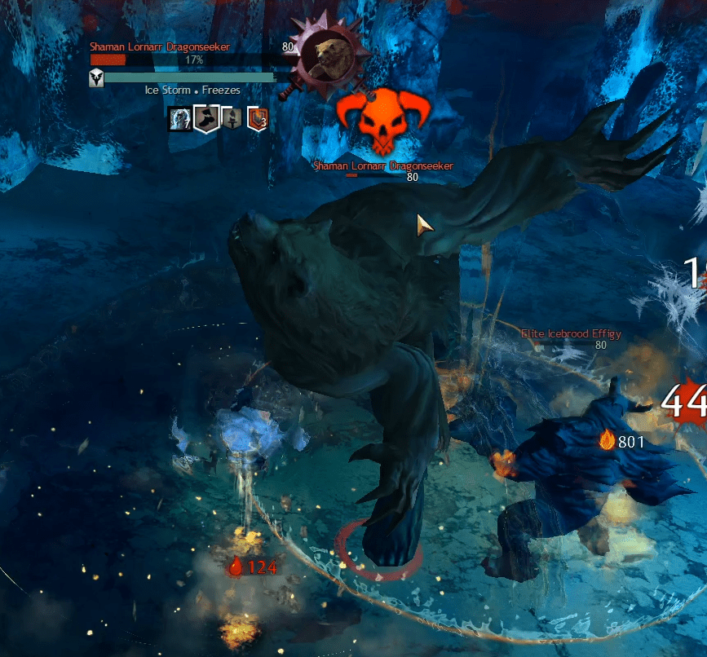
7. Final Boss: Shaman Lornarr DragonSeeker Pt. 3
At 20%, the Final boss turns into a Gigantic Bear called Shaman Lornarr Dragonseeker!
  There will be an Effigy as well so watch out for falling ice shards.
Best Strat: Make sure to use hard CC’s when its bar come up and kill both the boss and effigy as fast as you can. BIG DEEPS!!

Slide 9
Good luck & Have fun
If you have questions, Feel Free to DM me!

